Slide 1
Install and operate Cassandra
API Management
Notes:
Welcome to this elearning session about Apache Cassandra.
Cassandra is a key component for APIM so the main goal is to get you bacis skill on this solution
So you are going to learn the key concepts on Cassandra and how to install and operate it.

Slide 3
Understand Cassandra
Know Axway’s best practice for Apache Cassandra performances
Install Apache Cassandra database on a Virtual Machine (LAB)
Try first Cassandra commands (LAB)
Notes:
This module will show you what is Cassandra and why Axway choose it for APIM.
What APIM assets are stored in this database and what are the main commands to operate it.
We propose 2 labs, one to install Cassandra on a Virtual Machine, the second to try some commands.

Slide 4
Prerequistes

Slide 5
The latest reference environment
APIM installer 7.7
A 64-bit OpenJDK JRE or Oracle JRE version 8
https://support.axway.com/en/downloads/
https://openjdk.java.net/install/
Notes:
In this lab, you will need the reference environment.
Axway provides the Cassandra package inside the installer but you can download a package directly from the Cassandra Website.

Slide 6
Install Cassandra on VM
Cassandra overview
Notes:
Apache Cassandra is the official NoSQL Database used by the APIM solution.
Cassandra store multiple assets created by different components.
The recommended version is v3.11.11 since the APIM 7.7 August release 2021.
The previous version was v2.12.12.
To simplify its installation, the right Cassandra version is provided in API Gateway installer and part of the solution installation options.
Another course is available to upgrade Cassandra 2.2.12 to 3.11 for existing deployment.

Slide 7
What is Cassandra
Node 1
Open Source No SQL Database.
Adapted for High availability
2 importants parameters:
Replication factor: how many nodes contains the data
Consistency strategy: how many answers is required
Learn more about Apache Cassandra : https://cassandra.apache.org/doc/3.11/cassandra/getting_started/index.html
Node 4
Node 2
Node 3
Notes:
Let’s start by the Cassandra concepts.
Apache Cassandra is an open source, distributed and decentralized storage system (database), for managing very large amounts of data across many commodity servers.
Cassandra is classified as a NoSQL database.
simplicity of design
horizontal scaling
finer control over availability
Designed for high performance and high availability
Including multi-datacenter capabilities
No single point of failure
2 importants term need to be understanded. Fir the replication factor. It defines how many nodes will contain the data.
Then the Consistency Strategy, that define how many answers are required. This configuration is really important because it will define the robustness of your database but also his performances.
The client is CSQLH. We will learn few commands after that.

Slide 8
Cassandra for APIM
Data for API Manager.
API Gateway Client registry as API key and Oauth.
Cassandra is optional to store following Data:
Custom KPS table definition and data
Oauth Token stores
Notes:
Cassandra is the data repository for API Manager configuration, API Manager quotas and default OAuth tokens
Cassandra can be used for Key Property Store (KPS) policy capabilities as well
KPS gives autonomy and flexibility in API Gateway to manage simple data models
API Manager requires modification to be taken in account immediately, on all instances
Capabilities not delivered by API Gateway repository
API Manager architecture often requires multi-datacentre deployment
Regular SQL database is less suited than Cassandra to provide these capabilities.
3 deployment patterns are identified at Axway.
The standalone. It means that only one node is deployed. In this case, the consistency level must be One. This configuration is inside

Slide 9
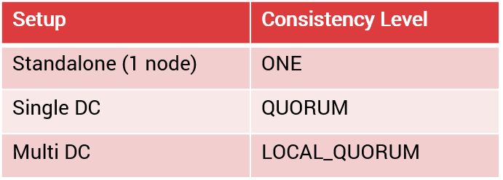

Replication and consistency
3 deployments patterns and their impacts :
Replication strategy:
Simple strategy: Default. One to 3 nodes in one DC.
Network Topology Strategy: When used with multiple Datacenters. Must be updated with a CQL commands.
Add sentences from Datastax.
Notes:
3 deployment patterns are identified at Axway.
The standalone. It means that only one node is deployed. In this case, the consistency level must be One. This configuration is inside.
Explain What is replication and Consistency.
Local_Quorum : We have to check if data is replicated corrected on each node on a Datacenter.

Slide 10
Replication and consistency
Exemple with multi Nodes
3
Node 1
+Johnny
5µs ack
Client
Read Johnny
Read consistency level = QUORUM
Read
3
1
Read
12µs ack
Node 4
2
Node 2
+Johnny
Read
Quorum for 4 nodes
=> 3 nodes
Read
12µs ack
4
500µs ack
Notes:
Use example, We have a consistency QUORUM.
Replication strategy:
Simple strategy: Default. One to 3 nodes in one DC.
Network Topology Strategy: When used with multiple Datacenters. Must be updated with a CQL commands.

Slide 11
Security best practices
Use a specific UNIX user account for Cassandra
Don’t use the Cassandra default user
Synchronise clocks between each Cassandra nodes
Use a Login/password minimally or a mutual authentication per certificate.
Encrypt end to end connection
Note: Encryption can lead to an overhead in Performance
Notes:
Cassandra User:
This user account must own all Cassandra related files, and it must be used to run the Cassandra process.
Failing to synchronize the clocks will result in:
Faults in data synchronization.
Failure to start or configure the machines correctly.
NTP must be configured.
Change minimally the default login/password.
Here is few examples.
Keep in mind that disk encryption, compression can impact the thep

Slide 12
Performance best practices
Optimize memory allocation with Jemaloc tool (http://jemalloc.net/)
Use SSD disk for lower read latency
Turn swap off
Use a dedicated mount point for all Cassandra installation
Adapt sizing of the JVM
Check logs at startup
Disable logging to stdout
Set u-limit for Cassandra user
Please consult to implement the previous recommendations : https://docs.axway.com/bundle/axway-open-docs/page/docs/cass_admin/cassandra_bestpractices/index.html
A powerful monitoring using JMX is required. Many tools provide some solutions;
Notes:
Jemaloc tool :
Useful to opmitise memory usage
Comme toute appli java, Cassandra utilise la JVM et donc la Heap pour stocker les objets / instance de classes en mémoire. D'après ce que je peux lire, lorsque le GC se met en pause, ça peut mettre la grouille chez Cassandra en ne purgeant pas ou pas assez rapidement les objets / instances de classe non utilisés. L'utilisation du off-heap permet de stocker des instances hors heap et Jemalloc permet de basculer des instances sur de off-heap et non de les mettre tous dans la Heap (soumise au GC)
[14:32] Olivier Valadier
c'est ce que je comprends
Check logs at startup
Cassandra executes basic performance and tuning checks at startup, and it writes warning messages to the console and to the system log file when issues are found.
Swap off:
Apache Cassandra recommends that swap is disabled.
Disable logging to stdout:
It’s recommended to disable the stdout logging appender because the default Cassandra configuration writes logs to stdout, which adds extra load to the pipe.
Configuration in conf/logback.xml
Set limit for Cassandra user.
Memlock must be unlimited
Nofile 100000
No proc = 32768
LimitAS=Infoinit

Slide 13
Cassandra Keyspace
Default keyspace format: X_Domainid_groupID
3 defaults collections :
API server, API
Oauth: Token and other objects related to oauth.
API Portal : Oganizations,
This 3 default collections aren’t visible from the API Gateway Manager.
Another keyspace for throttling: t_Domainid_groupID

Slide 14
Install and operate
Basic Installation

Slide 15
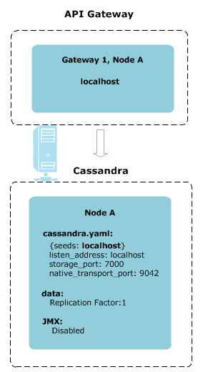
Apim run package: Simple way to install Cassandra
Tools : APIGateway_7.7_Install_linux-x86-32_BN<n>.run
Require Open JDK 8
A helper, not mandatory
Few options :
--help
--startCassandra 0
--cassandraInstalldir /opt/db/Cassandra
--cassandraJDK
Remove the Open JDK from lab
Notes:
The Axway installer can deploy an Cassandra package.
Basic installation is useful to answer

Slide 16
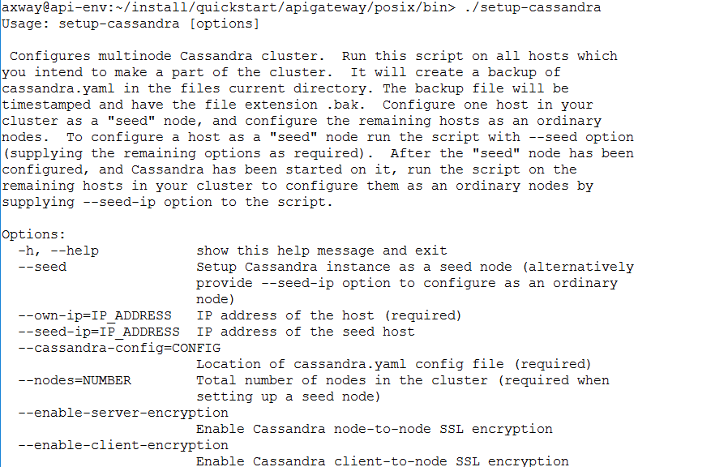
Setup-Cassandra : Simple way to configure Cassandra with multiple nodes
Tools : Apigateway/posix/bin/setup-Cassandra
A helper, not mandatory
Notes:
Axway provide a tool to manage and configure Cassandra.
With this command, you can enable server encryption, load certificates.

Slide 17
Administrate the cluster
Command : cassandra/bin/nodetool
Check that installation is working.
Repair nodes
See more actions on this chapter : https://docs.axway.com/bundle/axway-open-docs/page/docs/cass_admin/cassandra_ops/index.html
Notes:
Utility for Cassandra, to administrate cluster
Used in installation and other admin tasks
Ex:
nodetool repair - Repair one or more tables
nodetool status - Print cluster information (and see everything is working)
There are tools like medusa and reaper to automate nodetool repair and backup/restore

Slide 18
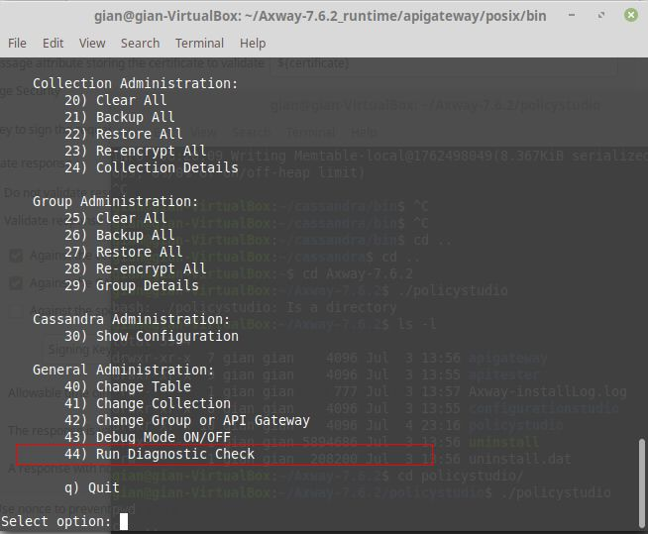
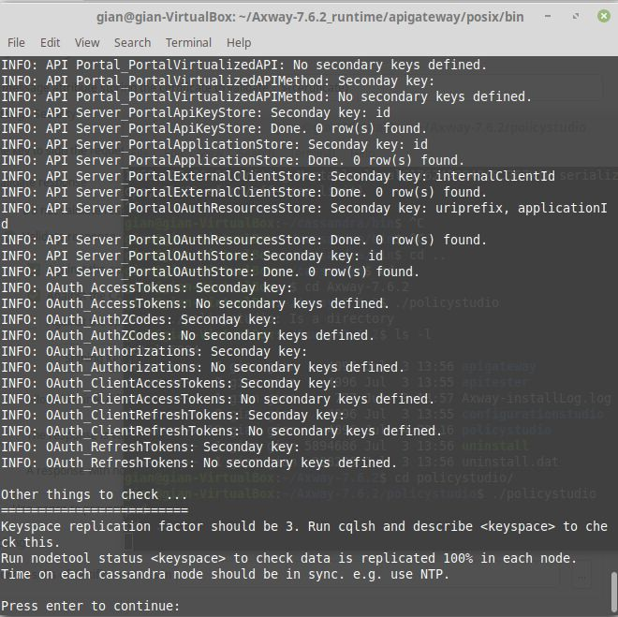
KPS administration capabilities
Provide KPS administration capabilities
Backup
Restore
Data CRUDL
Provide diagnostic capabilites

Slide 19
Language interpreter
Cassandra Query Language (CQL)
cassandra/bin/cqlsh
Keyspaces
Schema
User and password
CREATE USER apim WITH PASSWORD 'Niner2' SUPERUSER;
Never modify datas manually
Notes:
Cassandra Query Language (CQL)
Similar to SQL syntax

Slide 20
Install or upgrade Cassandra on VM
Basic installation

Slide 21
To show :
Create user, folders and set limits
Show packages on VM (prerequisites)
Install Apache Cassandra in unattended mode
Configure Cassandra ➔ Edit Cassandra YAML.
Start/Stop Cassandra database
Try basics CQL query (CQLSH):
Create user, set password
Show Keyspaces
Alter one table properties.
Alter keyspace Strategy.
Present KPS admin
Backup, restore
Notes:
Tree
# Create Cassandra user and group
groupadd cassandra
useradd -r cassandra –G Cassandra
# Check python version
python --version
# Install OpenJDK
sudo yum install java-1.8.0-openjdk-devel
java -version
# Install Cassandra
./APIGateway_7.7_Install_linux-x86-32_BN<n>.run --mode unattended --setup_type advanced --enable-components cassandra --disable-components apigateway,qstart,policystudio,analytics,configurationstudio,apimgmt,packagedeploytools --cassandraInstalldir /opt/db/cassandra --cassandraJDK /opt/jre --startCassandra 0
# Configure service
Try basics CQL Query
Keyspaces
Desc keyspaces
create keyspace sample_demo with replication ={'class':'SimpleStrategy','replication_factor':3};
Use sample_demo
Create table test;
Alter tables
For exemple, Clean up Cassandra repair history
ALTER TABLE system_distributed.repair_history WITH default_time_to_live = 604800; TRUNCATE system_distributed.repair_history; ALTER TABLE system_distributed.parent_repair_history WITH default_time_to_live = 604800; TRUNCATE system_distributed.parent_repair_history;
ALTER TABLE system_distributed.parent_repair_history WITH default_time_to_live = 604800; TRUNCATE system_distributed.parent_repair_history;
Set Encryption
Setup-cassandra --seed-ip=ipA --own-ip=ipB --cassandra-config=/opt/cassandra/conf/cassandra.yaml --enable-server-encryption

Slide 22

Prerequisites
Key Question: What are the rules of the Knowledge Check?
To be addressed by SME and CA
For each (or all of) the questions:
How many attempts per question (between 1 and Infinite)?
Result of the Quiz:
Validation of the quiz through a score or only by doing it?
What is the % of good answer for validating the entire quiz if needed ?
Do we allow the learner to review the Quiz ?
If he review does the learner see only where he failed or do we show him the good answers ?

Slide 23
Does Axway provide a Cassandra Package
No
Yes

Slide 24
What’s Cassandra version is available for a APIM 7.7 august 2021 release ?
4
2.2.19
3.11
All previous answers

Slide 25
What’s the steps to upgrade Cassandra ?
Save data
Install Cassandra v2.2.19
Migrate data from Cassandra v2.2.12 to v2.2.19
Backup Cassandra data
Install Cassandra v3.11
Migrate data from Cassandra v2.2.19 to v3.13

